Slide 1
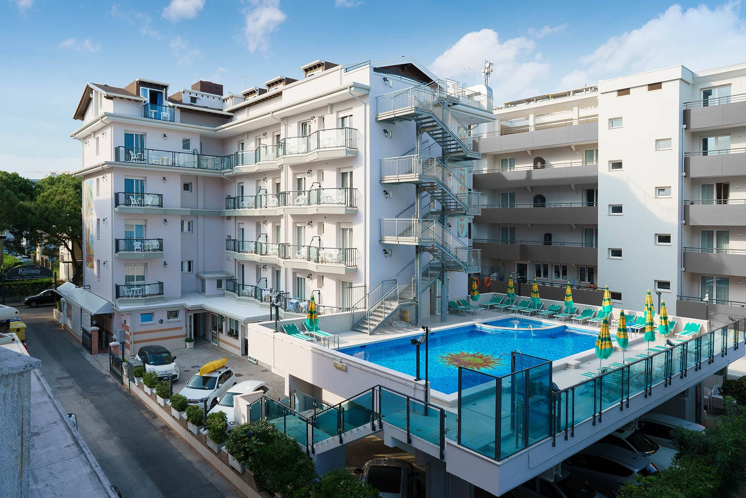
HOTEL MANAGEMENT SYSTEM
Data Structure & Algorithms (DSA)
PROJECT

Slide 2

OUTLINE:
Introduction
The Hotel Management System is designed to streamline and automate the operations of a hotel, including reservation management, guest check-in/check-out, room allocation, billing, and overall administration. The project aims to enhance the efficiency and accuracy of hotel management by leveraging the power of data structures and algorithms.
Uses and Advantages
Efficient Reservation System:
The system allows for easy and quick reservation of rooms, ensuring optimal occupancy.
Accurate Billing and Invoicing:
Automated billing processes prevent errors and simplify financial transactions.
Inventory Management:
Efficient tracking of available rooms, services, and resources.
Customer Relationship Management:
Improved customer service and satisfaction through personalized interactions and quick problem resolution.

Slide 3

Need for the Project
Operational Efficiency:
Streamlining day-to-day operations for hotel staff.
Accuracy:
Reducing errors in reservation and billing processes.
Customer Satisfaction:
Enhancing the overall experience for guests.
Competitive Edge:
Staying ahead in the competitive hospitality industry.
Tools Used
C++ Programming Language: (Primary language for system development.)
Integrated Development Environment (IDE): Include Code::Blocks, Visual Studio.

Slide 4

DSA Concepts Used
Arrays (rooms Array):
This is a data structure that allows for fast random access to elements. In this code, it is used to store Room objects, providing constant-time access to rooms based on their indices.
Linked Lists (rooms List):
This is a dynamic data structure where elements are stored in nodes, and each node points to the next one. In this code, it is used to manage rooms. When a new room is added, a pointer to that room is added to the linked list.
Queue (Booking Queue):
A queue is a First-In-First-Out (FIFO) data structure. In this code, it's used to manage reservations. When a reservation is made, it's added to the back of the queue (reservations.push(reservation)), and when a reservation is canceled, it's removed from the front of the queue (reservations.pop()).

Slide 5
Character Arrays (char name[50]):
These are used to store names of guests, events, and the hotel. strcpy is used to copy strings. The use of character arrays in this context is a basic representation of string handling in C++.
reservations.push(reservation):
This is an enqueue operation, adding a reservation to the back of the queue.
reservations.pop():
This is a dequeue operation, removing the front reservation from the queue.
Data Structures and Algorithms(DSA)
Linked Lists: For dynamic management of reservations, guest records, and room allocation.
Trees: To organize and search data, such as room availability or guest information.
Sorting Algorithms: For sorting records based on various parameters (e.g., check-in date, room type).

Slide 6
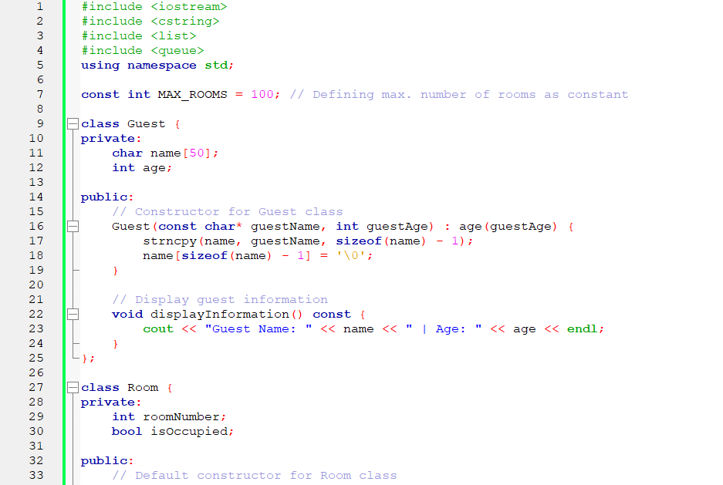
CODE:

Slide 7
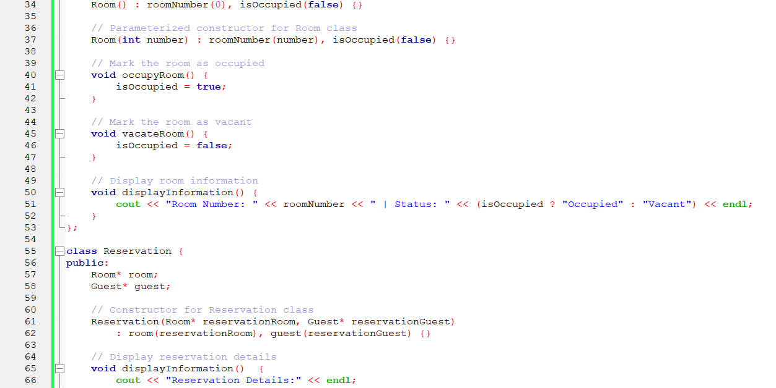

Slide 8
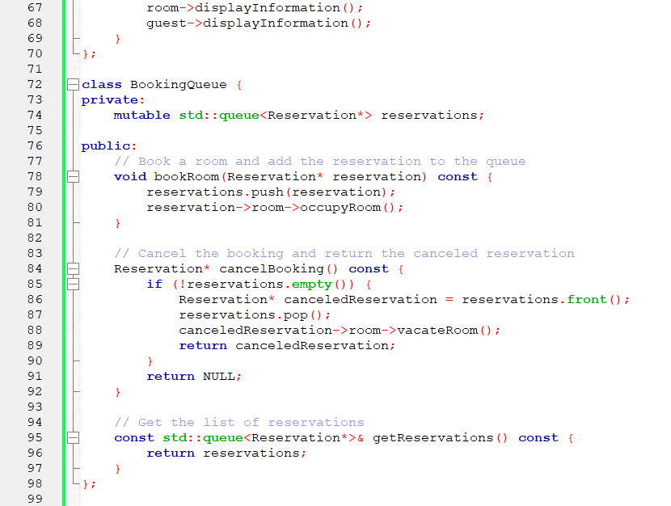

Slide 9
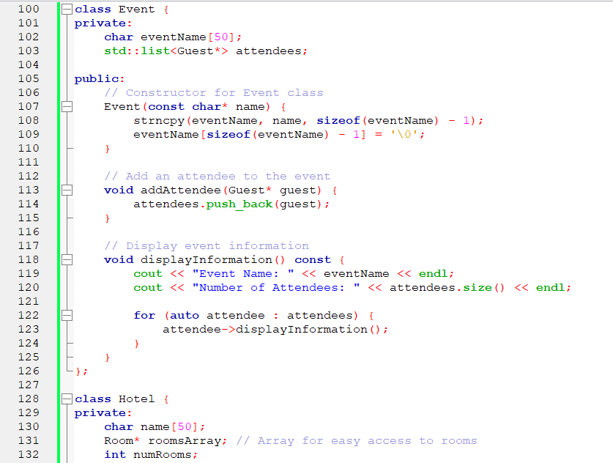

Slide 10
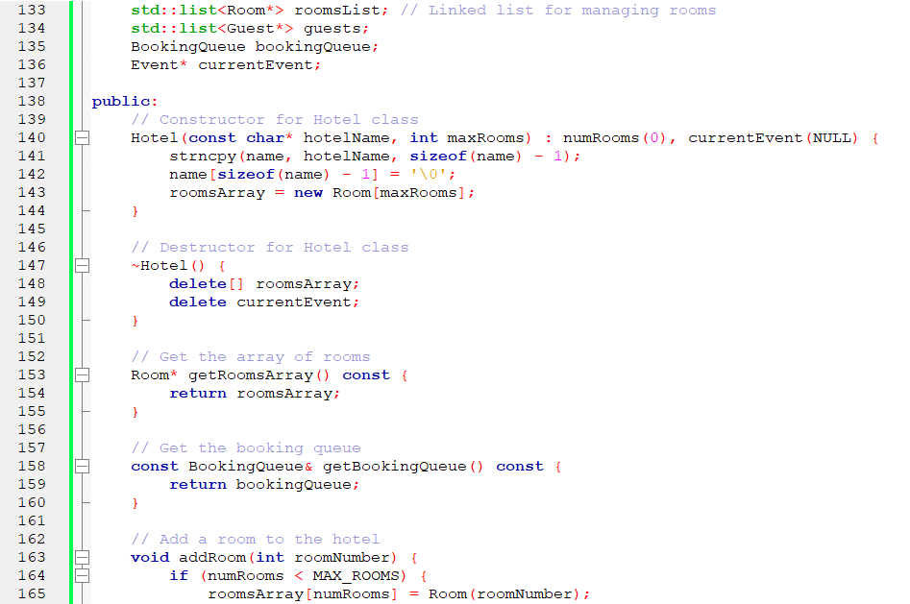

Slide 11
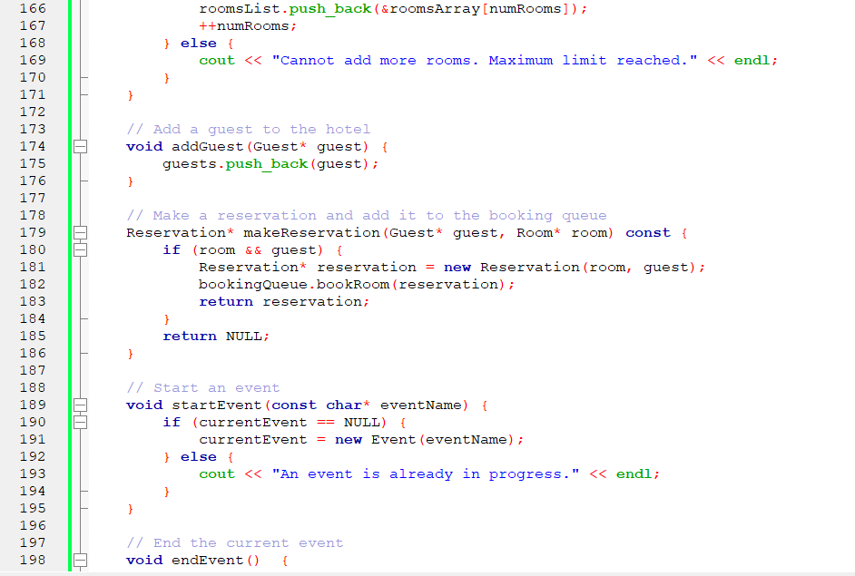

Slide 12
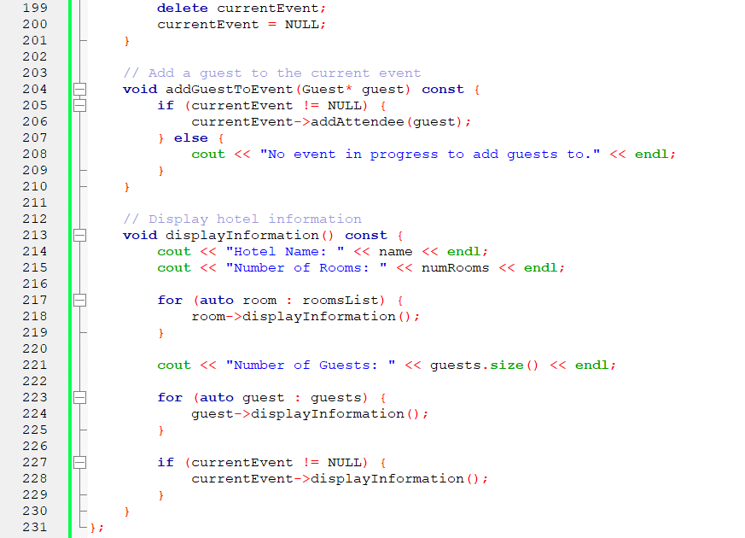

Slide 13
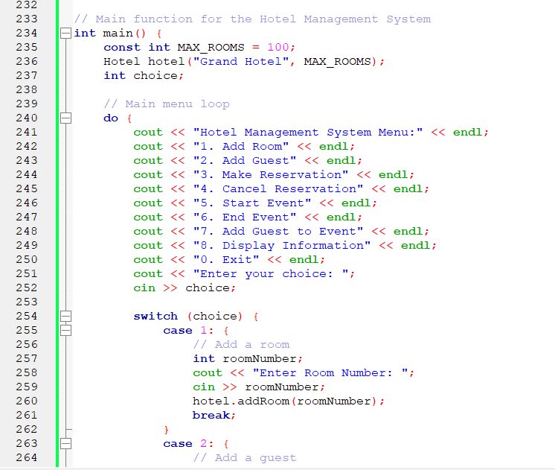

Slide 14
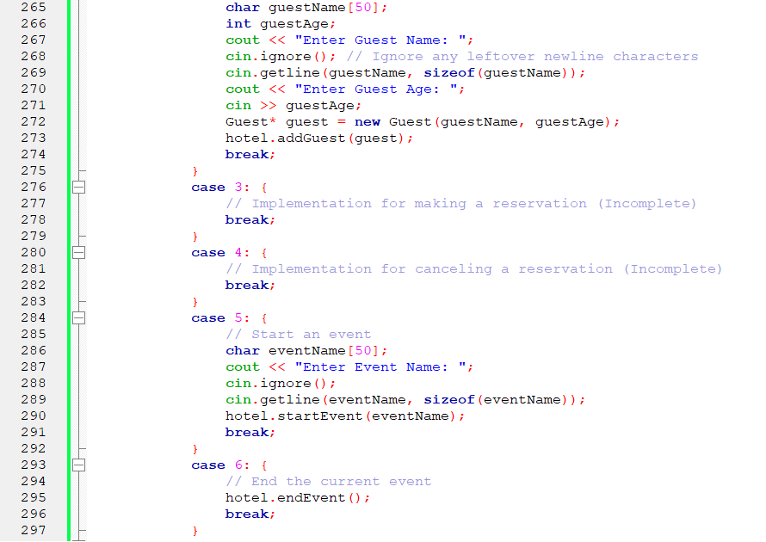

Slide 15
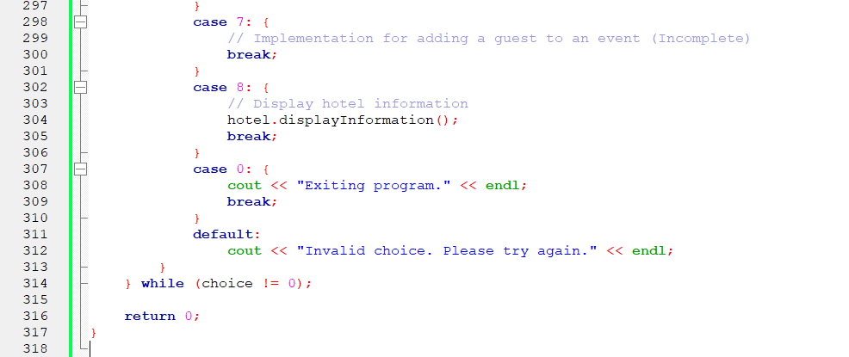

Slide 16
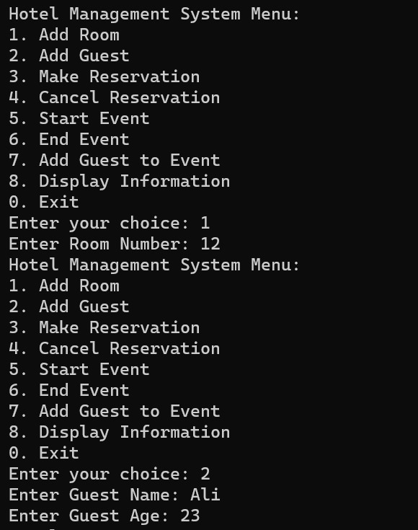
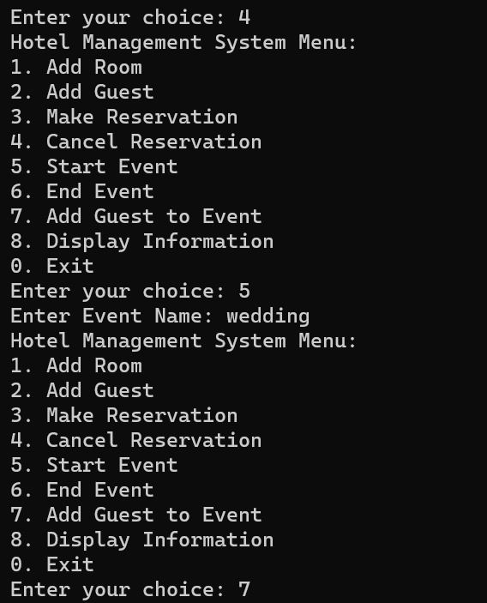
OUTPUT:

Slide 17
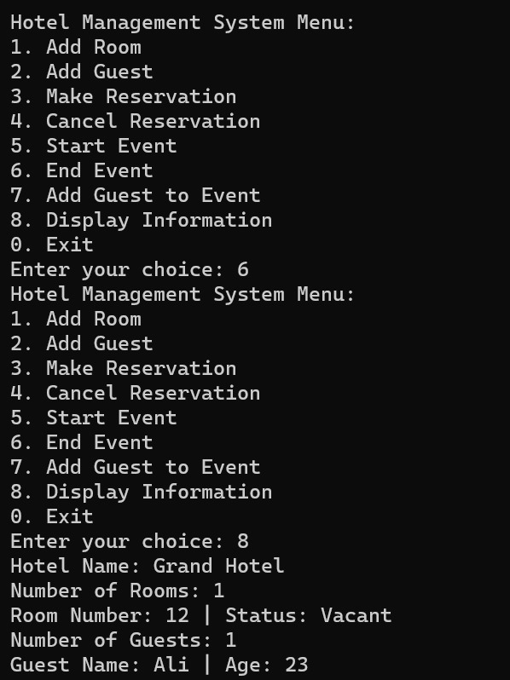
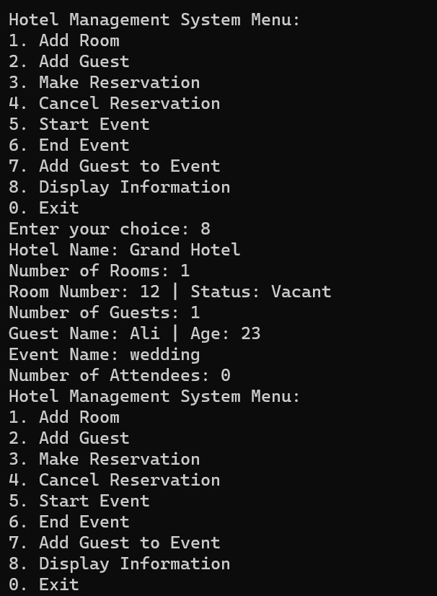

Slide 18
Conclusion
The Hotel Management System is a crucial tool for the modern hospitality industry, offering benefits in terms of operational efficiency, accuracy, and improved customer service. By utilizing C++ and incorporating data structures and algorithms, the system can provide a robust and scalable solution to address the challenges faced by hotels in their day-to-day operations.
Resources
Online tutorials and documentation for DSA projects.

